Slide 1
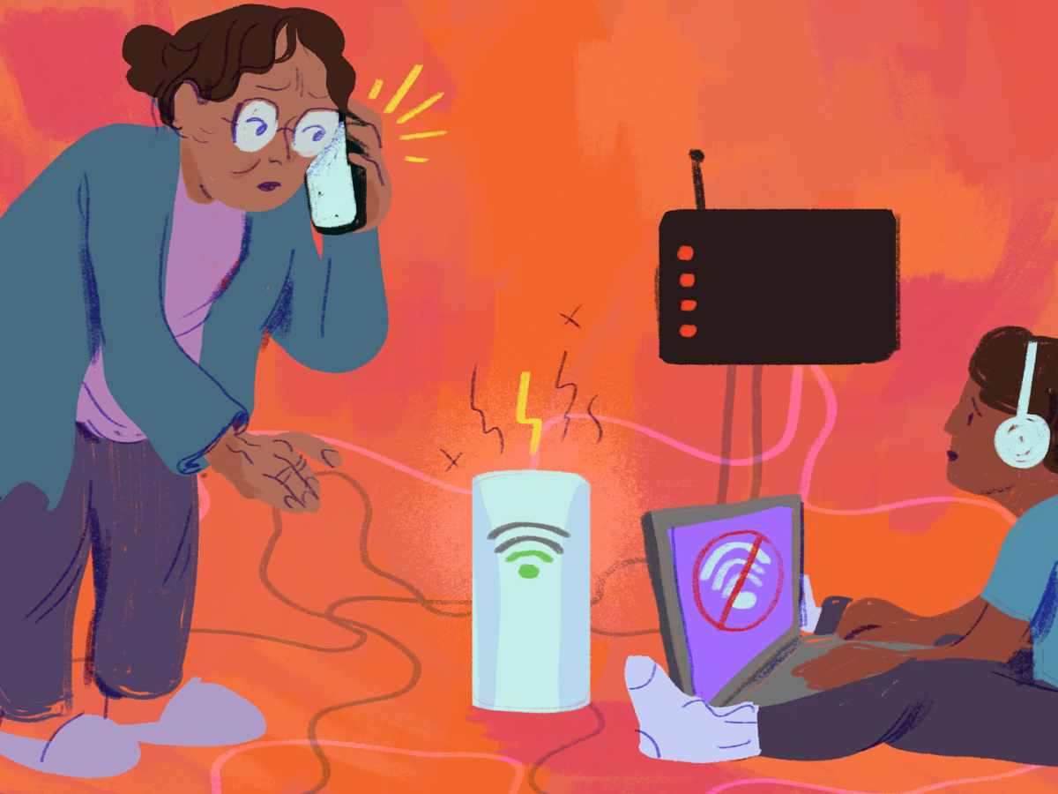

Slide 2

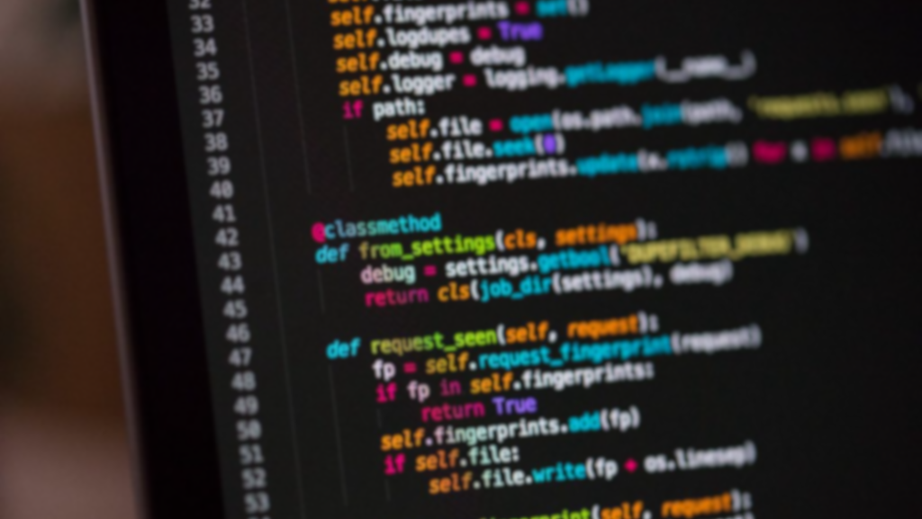
PUZZLE MEMORY GAME
Group Name: Memory Puzzle
Group Members: Joyce (Duong) Ngo, Aidan Koenigsberger, Ngwe Sin

Slide 3
What is Memory Puzzle?
Our project focused on recreating a digital version of the classic physical card game we used to play as kids.
Main purpose of the game is to correctly memorize the location of the matching pairs on the board and then identify where all the matching pairs of cards in the game are on the board within a set time period.

Slide 4

HOW TO PLAY
Different shapes and colors is laid out in a board. And the player must correctly identify each pair of matching shapes
Rules:
Identify all of the matches.
The player loses if the 5 second timer runs out and they are unable to find all matches.
The player will get approximately 10 seconds to memorize the board before the cards are flipped back down and the game begins.

Slide 5
Prototype
A quick demonstration of the current prototype we have.

Slide 6
Challenges….
Randomizing the cards on the board for every round.
Getting the title screen to return from game over screen
Matching cards function
Timer
Some lessons learned!
Keep your code organized (with comments!)
Conditions and dictionaries are useful
Global variables

Slide 7
Questions?

